Slide 1
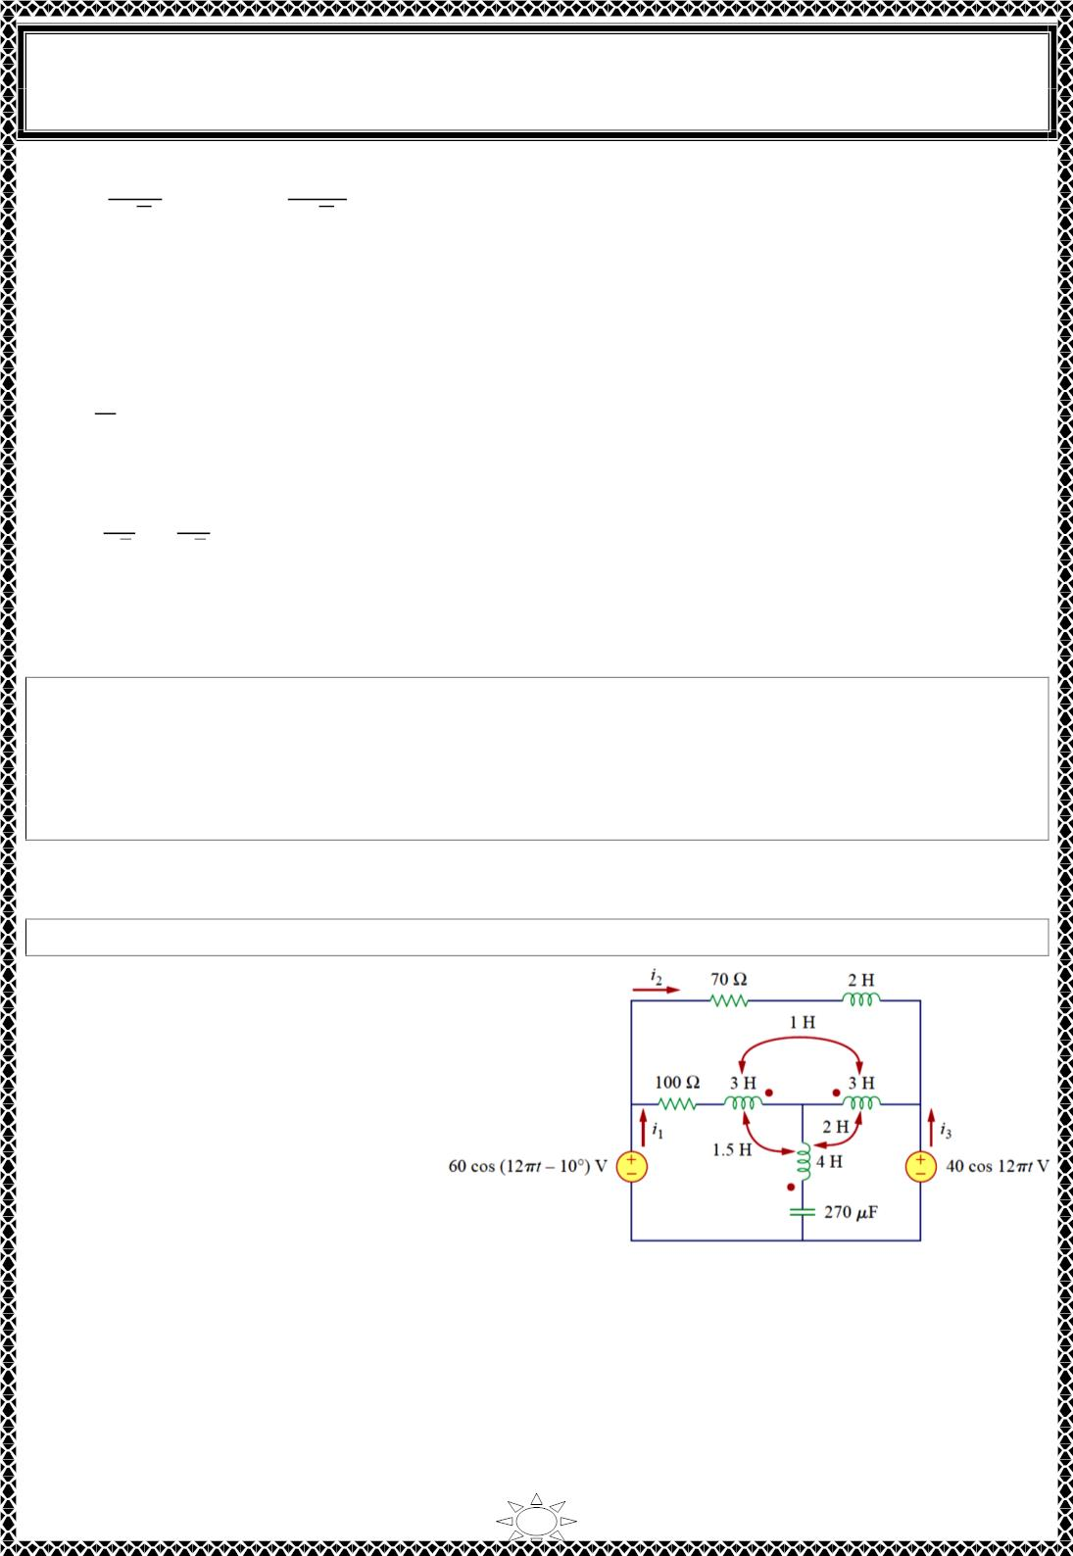
University of Diyala
Engineering College
Electronic Department
Electrical Circuits
2nd Class
Lecturer : Wisam N. AL-Obaidi
Year (2015-2016)
푛푉
5 푉
퐿푝
푉 =
퐿푝
→ 240 =
퐿푠
√3
∴ 푉_{퐿푝} = 83.14 푉
√3
(C) Because the load is balanced, each transformer equally shares the total load and since
there are no losses (assuming ideal transformers), the kVA rating of each transformer is
ꢀ푇
푆 = = 14 kVA
ꢁ
Or from primary side Y
푉 = 푉 = 240
퐿푝
퐿푠
^{ꢂ}ꢃꢄ
ꢅ9ꢅ
퐼 =
=
= 58.34 퐴
퐿푠
√ꢁ
√ꢁ
푆 = 240×58.34 = 14 푘푉퐴
Or you can find it from secondary side ∆
H.W.12: A three-phase - transformer is used to step down a line voltage of 625 kV, to
supply a plant operating at a line voltage of 12.5 kV. The plant draws 40 MW with a
lagging power factor of 85 percent. Find: (a) the current drawn by the plant, (b) the turns
ratio, (c) the current on the primary side of the transformer, and (d) the load carried by
each transformer.
Trail Version
Trail Version
Trail Version
Trail Version
Trail Version
Trail Version
Trail Version
Trail Version
Trail Version
Trail Version
Trail Version
Trail Version
Trail Version
Answer: (a) 2.1736 kA, (b) 0.02, (c) 43.47 A, (d) 15.69 MVA.
H.W. : find i , i , and i in Fig.
Answer:
1
2
3
퐼_{ꢆ} = 0.4654∠−70.25º A
퐼_{ꢅ} = 0.2114∠−75.75º A
퐼ꢁ = 0.10ꢇ5∠17.15º A
Or
푖_{ꢆ} = 0.4654 cꢈs(12휋푡−70.25º) A
푖_{ꢅ} = 0.2114 cꢈs(12휋푡−75.75º) A
푖ꢁ = 0.10ꢇ5 cꢈs(12휋푡 + 17.15º) A
26

Slide 2
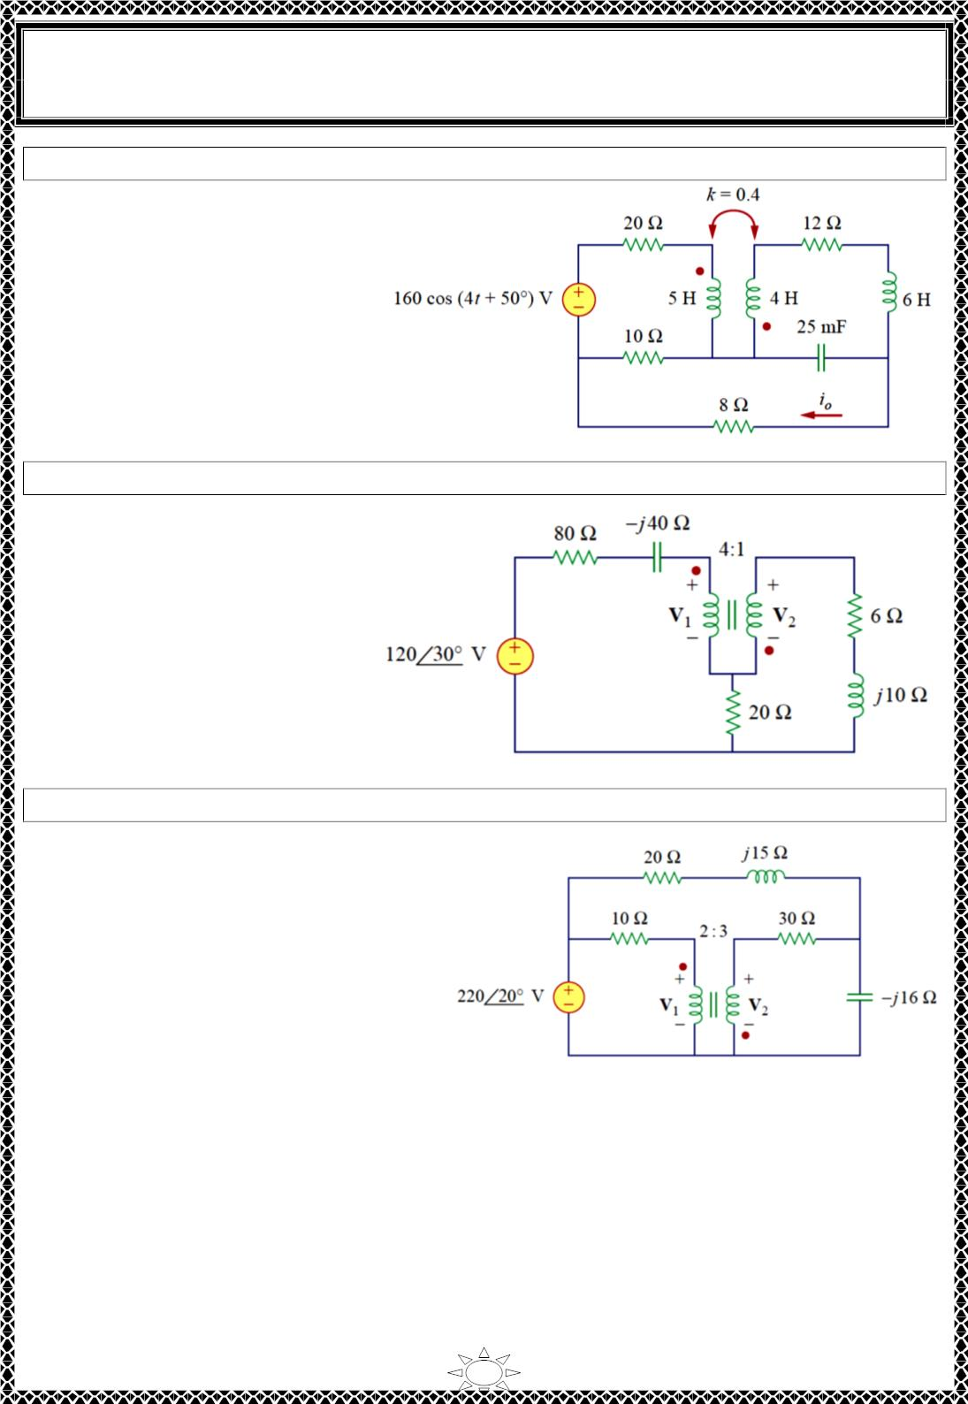
University of Diyala
Engineering College
Electronic Department
Electrical Circuits
2nd Class
Lecturer : Wisam N. AL-Obaidi
Year (2015-2016)
H.W. : find i_{o} in Fig.
Answer:
2.012 cos(4푡 + 68.52^{표}) A
H.W. : find V & V in the ideal transformer circuit of Fig.
Answer:
1
2
91.12∠37.92ꢀ V,
22.78∠−142.1ꢀ V
Trail Version
Trail Version
Trail Version
Trail Version
Trail Version
Trail Version
Trail Version
Trail Version
Trail Version
Trail Version
Trail Version
Trail Version
Trail Version
H.W. : find V & V in the ideal transformer circuit of Fig.
1
2
Answer:
138.82∠28.65ꢀ V, 208.2∠−151.4ꢀ V
27

Slide 3
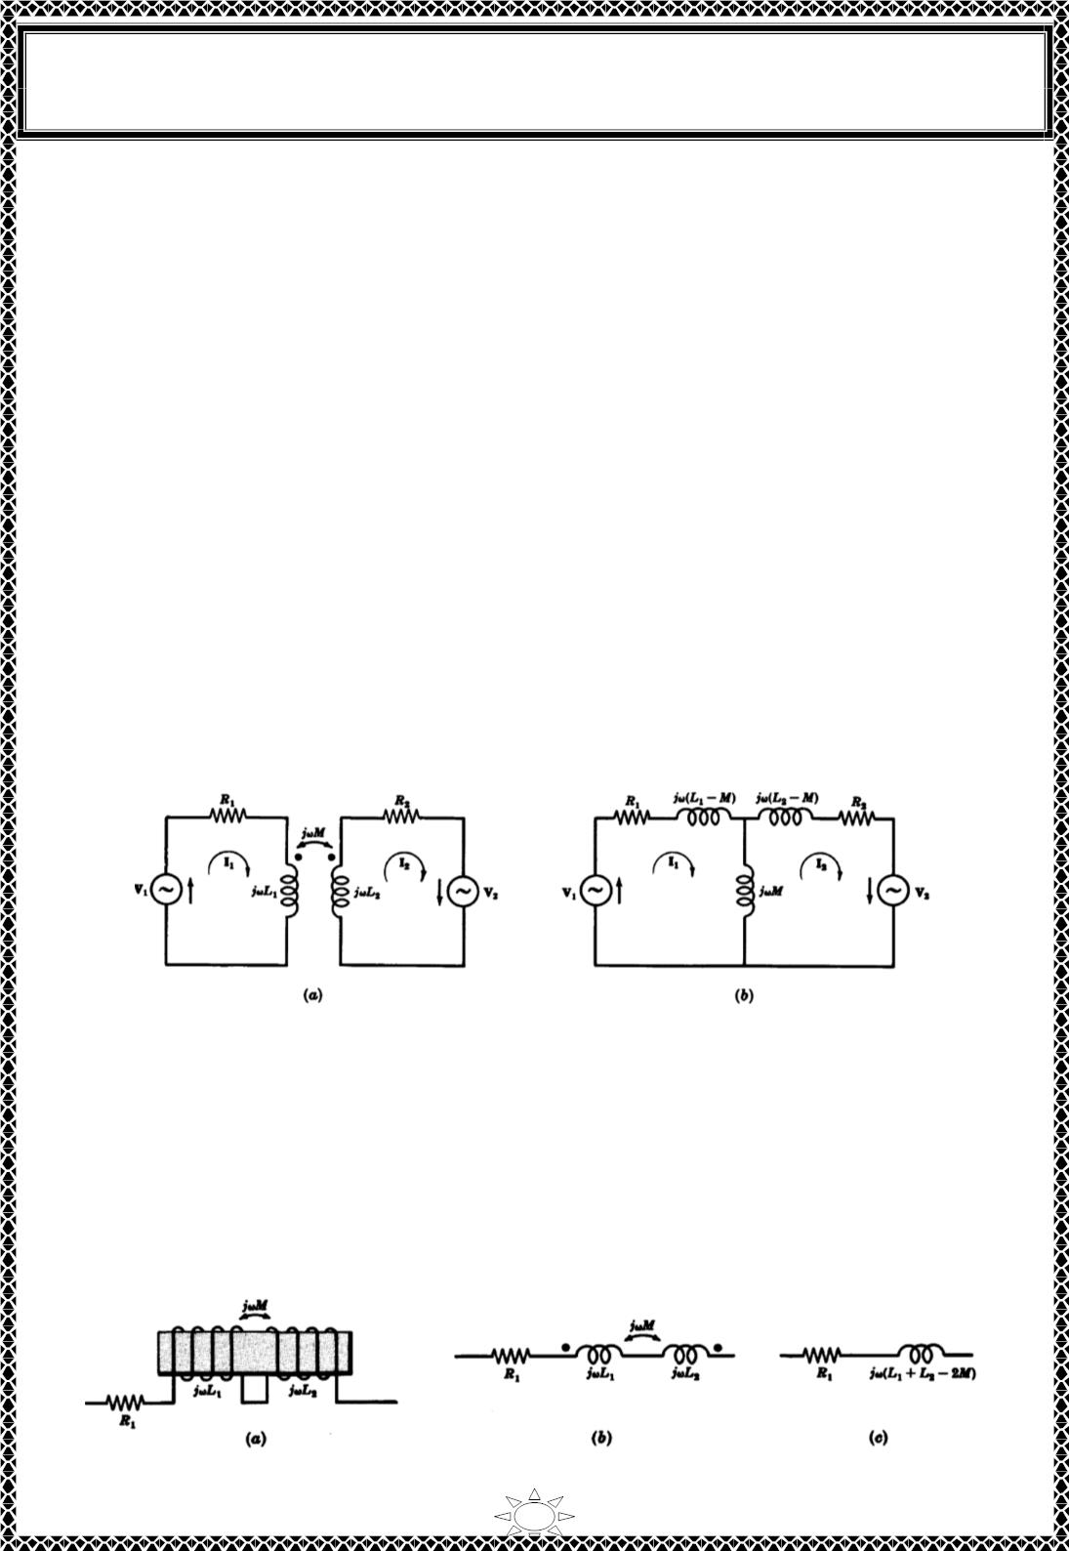
University of Diyala
Engineering College
Electronic Department
Electrical Circuits
2nd Class
Lecturer : Wisam N. AL-Obaidi
Year (2015-2016)
7) CONDUCTIVELY COUPLED EQUIVALENT CIRCUITS
It is possible in analysis to replace a mutually coupled circuit with a conductively coupled
equivalent circuit. For Fig.9(a) the mesh current equations are,
( 푅 + 푗휔퐿 )퐼 − 푗휔푀퐼 = V
…(27)
…(28)
1
1
1
2
1
−푗휔푀퐼 + ( 푅 + 푗휔퐿 )퐼 = V
2
1
2
2
2
Equ.s (27) & (28) can be written in matrix form as:
푅 + 푗휔퐿
−푗휔푀
푅 + 푗휔퐿 퐼
ꢀ
퐼ꢀ
V
[
ꢀ
] ꢂ
ꢀꢃ
ꢁ
−푗휔푀
ꢁ
ꢁ
ꢁꢃ = ꢂ_{V}
푍
ꢀꢀ
푍
ꢁꢀ
푍
푍
퐼
V
Or
ꢂ
ꢀꢁꢃ ꢂ ꢀꢃ = ꢂ ꢀꢃ
ꢁꢁ
퐼
V
ꢁ
ꢁ
Note that:
1) the first loop impedance is the sum of first column impedances
(Z +Z = 푅 + 푗휔퐿 − 푗휔푀)
11
21
1
1
2) the second loop impedance is the sum of second column impedances
(Z + Z = 푅 + 푗휔퐿 − 푗휔푀),
12
22
2
2
3) the common impedance between the two loops is the diagonal impedance (-Z or
Trail Version
Trail Version
Trail Version
Trail Version
Trail Version
Trail Version
Trail Version
Trail Version
Trail Version
Trail Version
Trail Version
Trail Version
Trail Version
11
-Z₂₂ = 푗휔푀)
the conductively copled circuit is shown in Fig.9(a).
Fig.9
Note : The above method of analysis does not always lead to a physically realizable
equivalent circuit. This is true when M > L or M > L .
1
2
To replace the series connection of the mutually coupled coils shown in Fig.10 (a),
proceed in the following manner. First apply the methods described above and obtain the
dotted equivalent shown in Fig.10 (b). Then replace the dotted equivalent by the
conductive equivalent shown in Fig.10 (c).
Fig.10
28

Slide 4
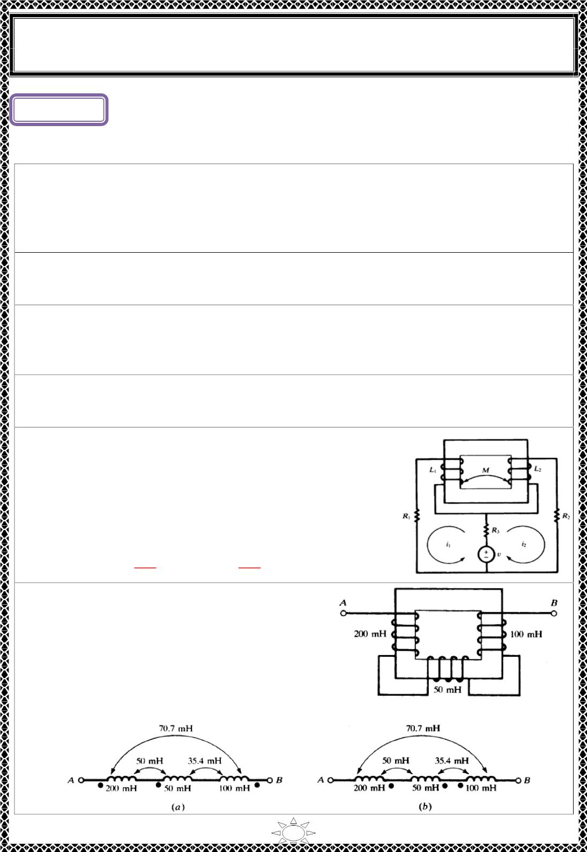
University of Diyala
Engineering College
Electronic Department
Electrical Circuits
2nd Class
Lecturer : Wisam N. AL-Obaidi
Year (2015-2016)
Lecture ()
MagneticallyCoupled Circuits
Problems
H.W.(1): Two coils have a coupling coefficient 푘 = .85 and coil 1 has 250 turns. With a
−4
current 푖 = 2 amp in coil 1, the total flux 휑 is 3.0 × 10 weber. When is reduced
1
1
푖
1
linearly to zero in two milli‐ seconds the voltage induced in coil2 is 68.75 volts. Find
퐿 , 퐿 , 푀 and 푁 .
1
2
2
[Answer: 37.5 풎푯, 150 mH, 63.8 풎푯, 500]
H.W.(2): Two coupled coils, L = 0.8 H and L = 0.2 H, have a coefficient of coupling k =
1
2
0.90. Find the mutual inductance M and the turns ratio N =N .
[Answer: 0.36 H, 2]
1
2
H.W.(3): Two coupled coils, N =100 and N = 800, have a coupling coefficient k =0.85.
1
2
With coil 1 open and a current of 5 A in coil 2, the flux is ∅ = 0.35 mWb. Find L , L , and
M.
2
1
2
[Answer: 0.875 mH, 56 mH, 5.95 mH]
H.W.(4): Two identical coupled coils have an equivalent inductance of 80 mH when
Trail Version
Trail Version
Trail Version
Trail Version
Trail Version
Trail Version
Trail Version
Trail Version
Trail Version
Trail Version
Trail Version
Trail Version
Trail Version
connected series aiding, and 35 mH in series opposing. Find L , L , M, and k.
1
2
[Answer: 28.8 mH, 28.8 mH, 11.25 mH, 0.392]
H.W.(5): Write the mesh current equations for the coupled
circuit shown in Fig. shown. Obtain the dotted equivalent
circuit and write the same equations.
[Answer]
(푹
(푹 + 푹 )풊 + 푳
ퟐ
풅풊_{ퟐ}
풅풕
+ 푹_{ퟑ}풊_{ퟏ} + 푴
풅풊_{ퟏ}
풅풕
= 풗
ퟐ
ퟑ
ퟐ
H.W.(6): Obtain two forms of the dotted
equivalent circuit for the coupled coils shown in
Fig.
[Answer]
1

Slide 5
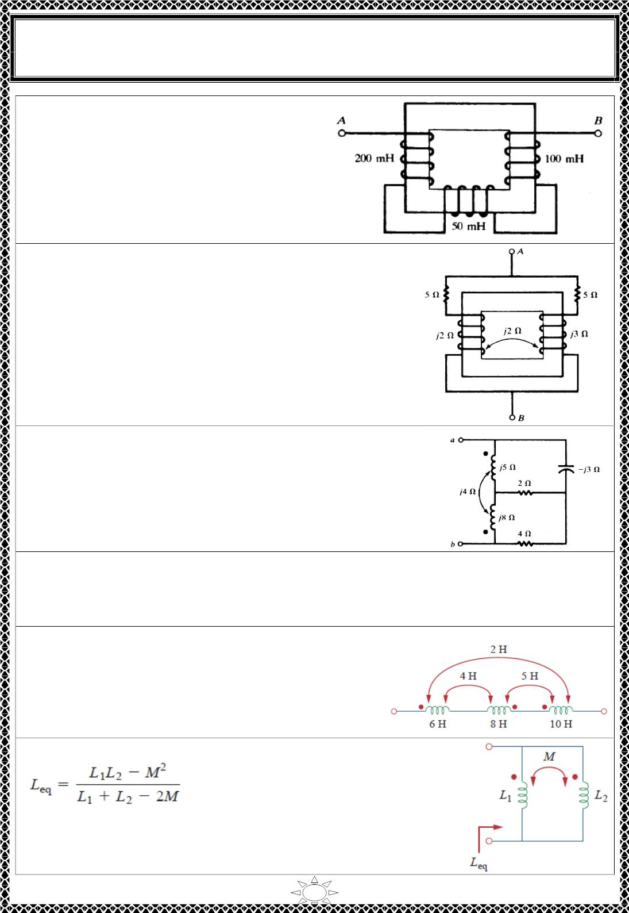
University of Diyala
Engineering College
Electronic Department
Electrical Circuits
2nd Class
Lecturer : Wisam N. AL-Obaidi
Year (2015-2016)
H.W.(7): The three coupled coils shown in
Fig. have coupling coefficients of 0.5. Obtain
the equivalent inductance between the
terminals AB.
[Answer: 239 mH]
H.W.(8): (a) Obtain the equivalent impedance at terminals
AB of the coupled circuit shown in Fig. shown (b) Reverse
the winding sense of one coil and repeat.
[Answer: 풂ꢀퟑ. ퟒ∠ퟒퟏ. ퟔퟔ^{ퟎ훀, (풃)ퟐ. ퟓퟒ∠ퟓ. ퟑퟕퟎ훀}
]
Trail Version
Trail Version
Trail Version
Trail Version
Trail Version
Trail Version
Trail Version
Trail Version
Trail Version
Trail Version
Trail Version
Trail Version
Trail Version
H.W.(9): For the coupled circuit shown in Fig., find the input
impedance at terminals ab.
[Answer: 6.22 ‏+ j4.65 Ω]
H.W.(10): Two coils are mutually coupled, with L = 25 mH, L = 60 mH, and k = 0.5.
1
2
Calculate the maximum possible equivalent inductance if: (a) the two coils are connected
in series (b) the coils are connected in parallel
[Answer:123.7 mH, 24.31 mH]
H.W.(11): For the three coupled coils in Fig. shown,
calculate the total inductance.
[Answer:10H]
H.W.(12): For the coupled coils in Fig. shown, show that
[Answer:]
2

Slide 6
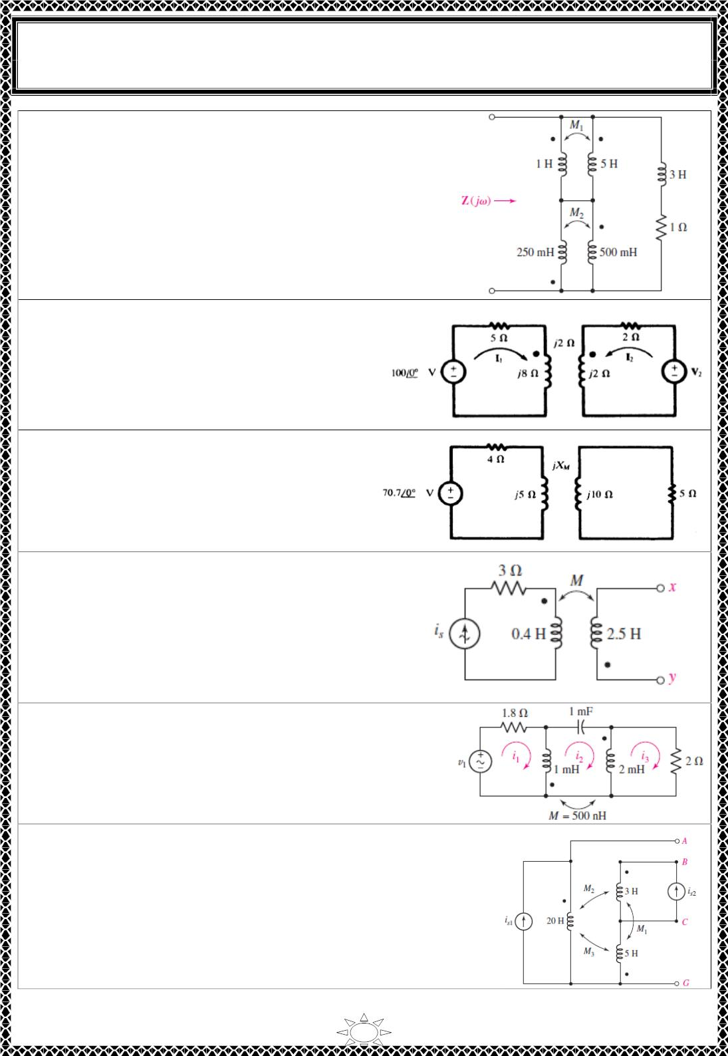
University of Diyala
Engineering College
Electronic Department
Electrical Circuits
2nd Class
Lecturer : Wisam N. AL-Obaidi
Year (2015-2016)
H.W.(13): With respect to the network shown in Fig.
shown, derive an expression for Z( jω) if M and M are
set to their respective maximum values.
1
2
[Answer
H.W.(14): In the coupled circuit shown in
Fig. , find V for which I = 0. What voltage
2
1
appears at the 8 Ω inductive reactance under
this condition?
[Answer:
ퟏퟒퟏ. ퟒ∠−ퟒퟓ^{ퟎ}퐕, ퟏퟎퟎ∠ퟎ^{ퟎ}퐕 (+퐚퐭 퐝퐨퐭)]
H.W.(15): Find the mutual reactance X_{M}
for the coupled circuit of Fig, if the average
power in the 5Ω resistor is 45.24 W.
Trail Version
Trail Version
Trail Version
Trail Version
Trail Version
Trail Version
Trail Version
Trail Version
Trail Version
Trail Version
Trail Version
Trail Version
Trail Version
[Answer:4Ω]
H.W.(16): Let is = 2 cos 10t A in the circuit of
Fig. shown, and find the total energy stored in the
passive network at t = 0 if k = 0.6 and terminals x
and y are (a) left open-circuited; (b) short-
circuited.
[Answer: 0.8 J; 0.512 J.]
H.W.(17): For the circuit of Fig, (a) draw the phasor
representation; (b) write a complete set of mesh
equations; (c) calculate i (t) if v (t) = 8 sin 720t V.
2
1
[Answer:]
H.W.(18): For the circuit of Fig. shown, M = 1 H, M = 1.5
1
2
H, and M = 2 H. If i = 8 cos 2t A and i = 7 sin 2t A,
3
s1
s2
calculate (a) V ; (b) V ; (c) V .
AB
AG
CG
[Answer:]
3

Slide 7
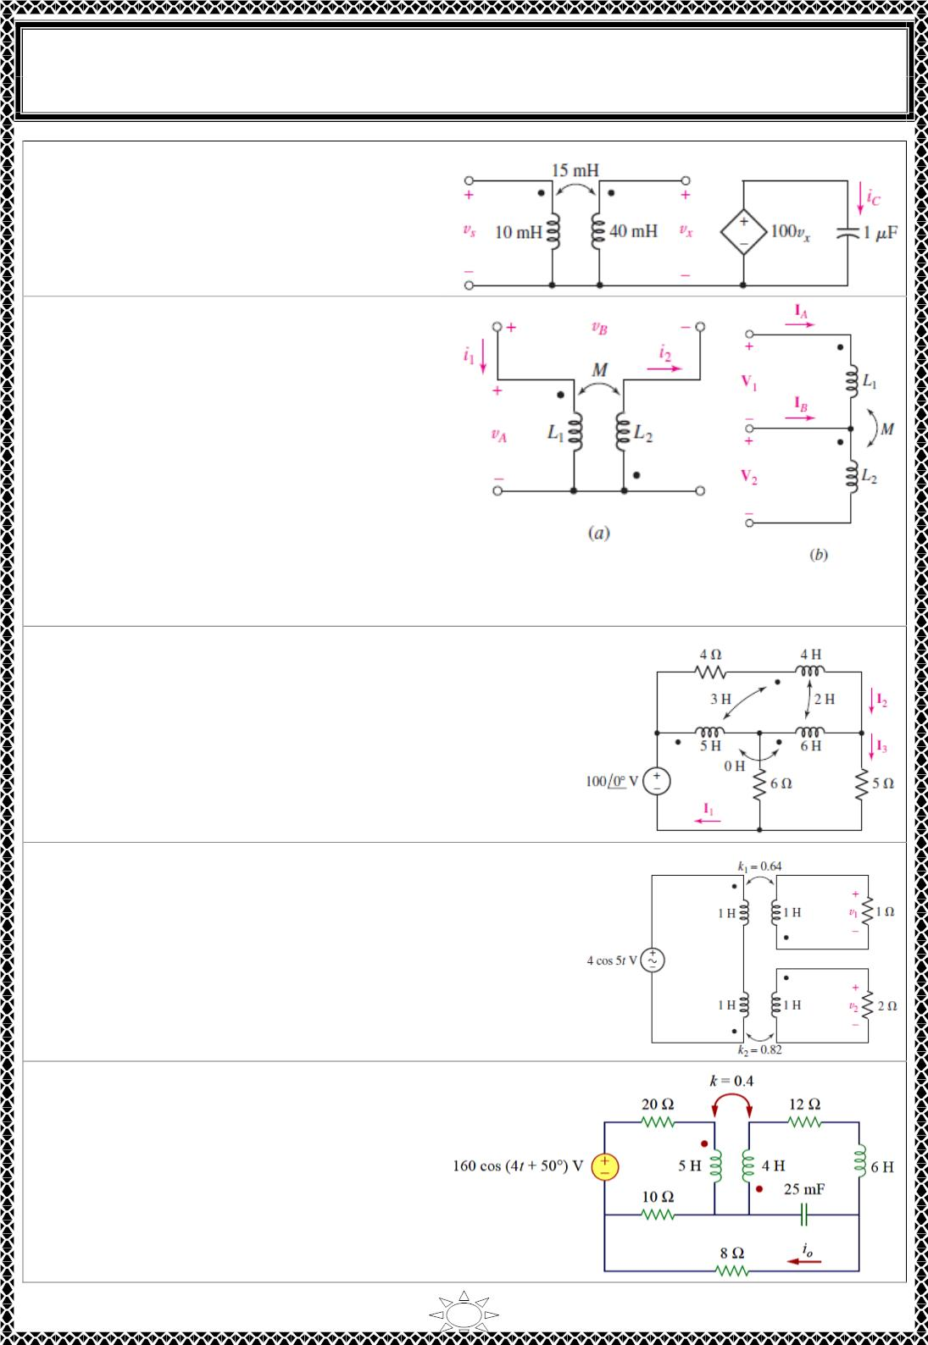
University of Diyala
Engineering College
Electronic Department
Electrical Circuits
2nd Class
Lecturer : Wisam N. AL-Obaidi
Year (2015-2016)
H.W.(19): Determine an expression for
i (t) valid for t >0 in the circuit of Fig.
C
2
2
shown , if v (t) =10t u(t)/(t + 0.01) V.
s
[Answer:]
H.W.(20): For the coupled inductor
network of Fig.a, set L = 20 mH, L = 30
1
2
mH, M = 10 mH, and obtain equations for
v and v if (a) i = 0 and i = 5 sin 10t; (b)
A
B
1
2
i = 5 cos 20t and i = 2 cos (20t – 100◦)
1
2
mA. (c) Express V and V as functions of
1
2
I and I for the network shown in Fig. b.
A
B
[Answer:]
Trail Version
Trail Version
Trail Version
Trail Version
Trail Version
Trail Version
Trail Version
Trail Version
Trail Version
Trail Version
Trail Version
Trail Version
Trail Version
H.W.(21): Note that there is no mutual coupling
between the 5 H and 6 H inductors in the circuit of Fig.
shown. (a) Write a set of equations in terms of I₁(jω),
I ( jω), and I ( jω). (b) Find I (jω) if ω = 2 rad/s.
2
3
3
[Answer:]
H.W.(22): Compute v , v , and the average power
1
2
delivered to each resistor in the circuit of Fig. shown.
[Answer:]
H.W.(23):find i_{o} in Fig.
[Answer:
ퟐ. ퟎퟏퟐ 퐜퐨퐬 ퟒ풕 + ퟔퟖ. ퟓퟐ^{풐}ꢀ 퐀]
4

Slide 8
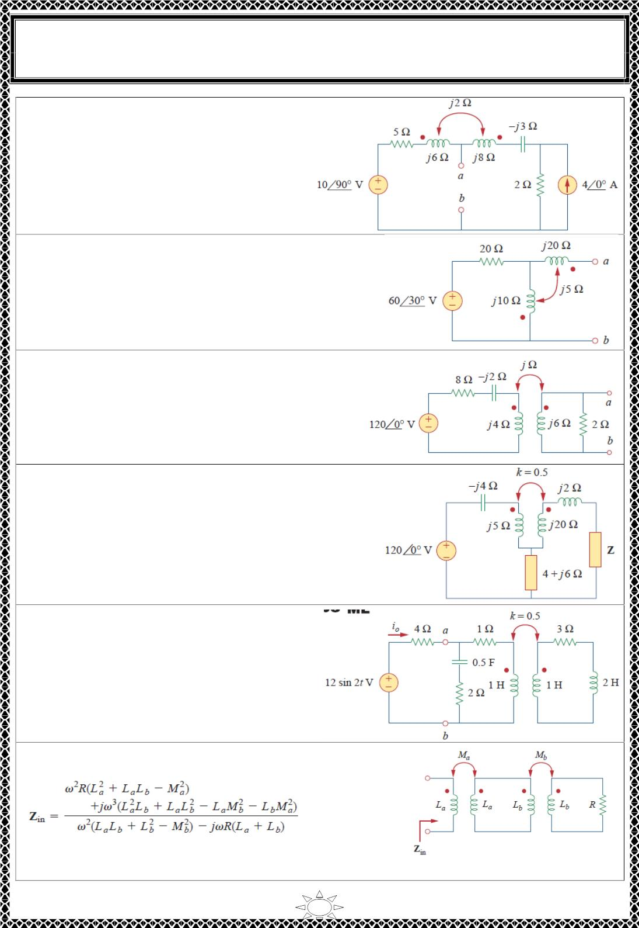
University of Diyala
Engineering College
Electronic Department
Electrical Circuits
2nd Class
Lecturer : Wisam N. AL-Obaidi
Year (2015-2016)
H.W.(24):
Obtain
the
Thevenin
equivalent circuit for the circuit in Fig.
shown at terminals a-b.
[Answer:V_{Th} = 5.349∠34.11°, Z_{Th}
2.332∠50°ohms]
=
H.W.(25): Find the Norton equivalent for the circuit
in Fig. shown at terminals a-b.
[Answer:I_{N} = 1.404∠9.44°A, Z_{N} = (1 + j19.5)
ohms]
H.W.(26): Find the Norton equivalent for the
circuit in Fig. shown at terminals a-b.
Trail Version
Trail Version
Trail Version
Trail Version
Trail Version
Trail Version
Trail Version
Trail Version
Trail Version
Trail Version
Trail Version
Trail Version
Trail Version
[Answer: I_{N}
=
1.6246∠-12.91°A, Z_{N}
=
1.894∠19.53°ohms]
H.W.(27): Find the Thevenin equivalent to the left of
the load Z in the circuit of Fig.
[Answer:V_{TH} = 61.37∠-46.22°A, Z_{TH} = (2.215 +
j29.12) ohms]
H.W.(28): For the network in Fig. , find Z_{ab}
and I_{o}.
[Answer: Z_{ab} = 1.5085∠17.9°ohms io =
2.2sin(2t – 4.88°) A]
H.W.(29): Two linear transformers are cascaded as
shown in Fig.. Show that
[Answer:]
5

Slide 9
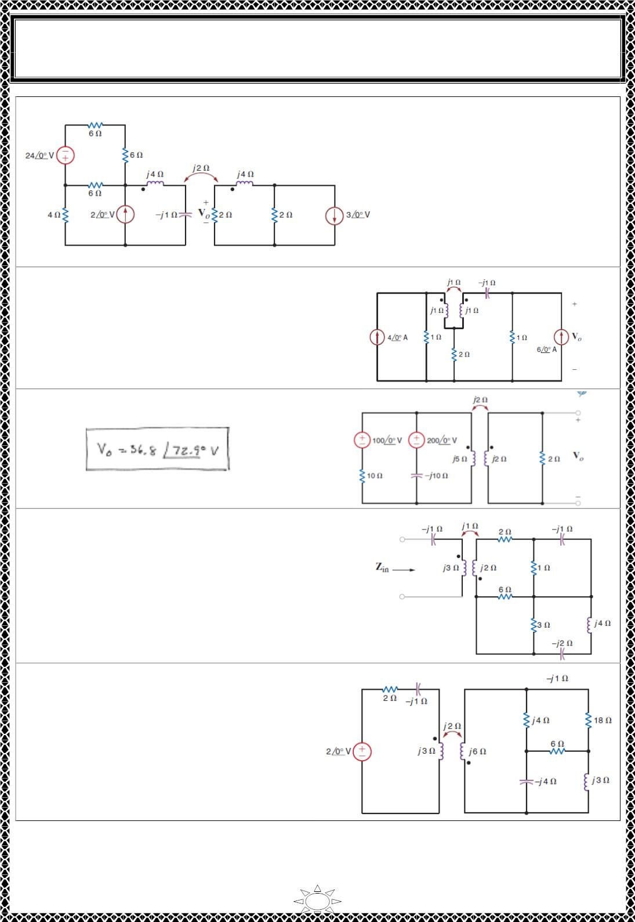
University of Diyala
Engineering College
Electronic Department
Electrical Circuits
2nd Class
Lecturer : Wisam N. AL-Obaidi
Year (2015-2016)
H.W.(30):FindV_{o}in the network in Fig. shown.
[Answer:]
H.W.(31): Find V_{o} in the network in Fig. shown.
[Answer:]
H.W.(32):Find V_{o} in the network in Fig. shown.
Trail Version
Trail Version
Trail Version
Trail Version
Trail Version
Trail Version
Trail Version
Trail Version
Trail Version
Trail Version
Trail Version
Trail Version
Trail Version
[Answer:
]
H.W.(33): Determine the impedance seen by the
source in the network in Fig. shown.
[Answer:]
H.W.(34): Determine the impedance seen
by the source in the network in Fig.
shown.
[Answer:]
6

Slide 10
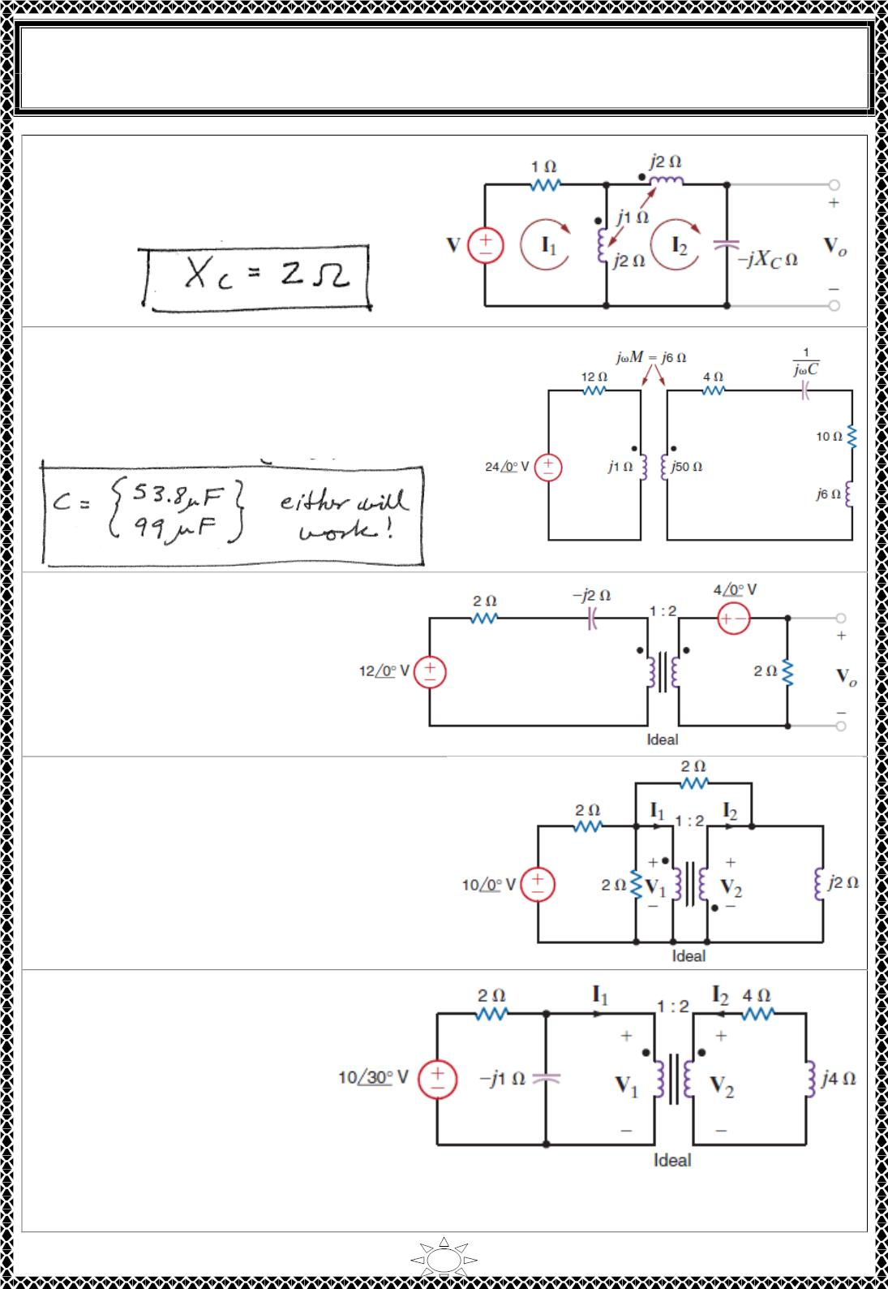
University of Diyala
Engineering College
Electronic Department
Electrical Circuits
2nd Class
Lecturer : Wisam N. AL-Obaidi
Year (2015-2016)
H.W.(35):determine the value of X_{C}
such that the output voltage is equal to
twice the input voltage.
[Answer:
]
H.W.(36):determine the value of the capacitor
C that will cause the impedance seen by the
24∠0° V voltage source to be purelyresistive, f
=60 Hz.
[Answer]
H.W.(37):Given the network in
Fig. shown, form an equivalent
circuit for the transformer and
primary, and use the resultant
network to compute V_{o}.
Trail Version
Trail Version
Trail Version
Trail Version
Trail Version
Trail Version
Trail Version
Trail Version
Trail Version
Trail Version
Trail Version
Trail Version
Trail Version
[Answer:V_{o}= 3.12∠38.66° V.]
H.W.(38):Determine I , I , V , and V in
1
2
1
2
the network in Fig. shown.
[Answer:
V₂ = 1.71∠-160° V.
V₁ = 0.85∠20° V;
I₂ = 1.54∠166.3° A;
I₁ = 3.08∠-13.7° A]
H.W.(39):Determine I , I ,
1
2
V and V in the network in
1
2
Fig. shown.
[Answer:]
7

